Slide 1


Bank of Baroda Hackathon - 2022
Technology Partner
Your Team Name : Team Soul
Your team bio : We are Engineering Students Passionate about Technology
Date : 20/09/2022

Slide 2
Problem Statement?
Virtual Assistant
Customers visit different digital channels, during this journey, they may require help to fulfill the process requirement, many times customers do not complete the process / transaction as they do not have full information. Virtual Assistant may help to increase the adoption of digital channels and reduce the cost of operation.

Slide 3
User Segment
Technavio has segmented the virtual assistant market market by end-user (automotive, BFSI, government, retail, and others) ,type (spoken commands and text-to-speech) , and geography (North America, APAC, Europe, South America, and MEA).
Working
Speech to Text
Text Analysing
Interpret Commands

Slide 4
Pre-Requisite
Hardware Requirements
A phone with touch screen Interface
Minimum Ram of 512MB
Internet Connectivity
USB Debugging Option in Mobile
Software Requirements
OS should be Android 4.1/ Win 8.1/ IOS 6 Higher
Kernel Version should be 3.0.16 or Higher
Support of other basic apps like Maps, Calendar, Camera, Web Connection etc.

Slide 5
Azure tools or resources
AZURE BOT SERVICE Azure Bot Service provides an integrated development environment for bot building. Its integration with Power Virtual Agents, a fully hosted low-code platform, enables developers of all technical abilities build conversational AI bots—no code needed.

Slide 6
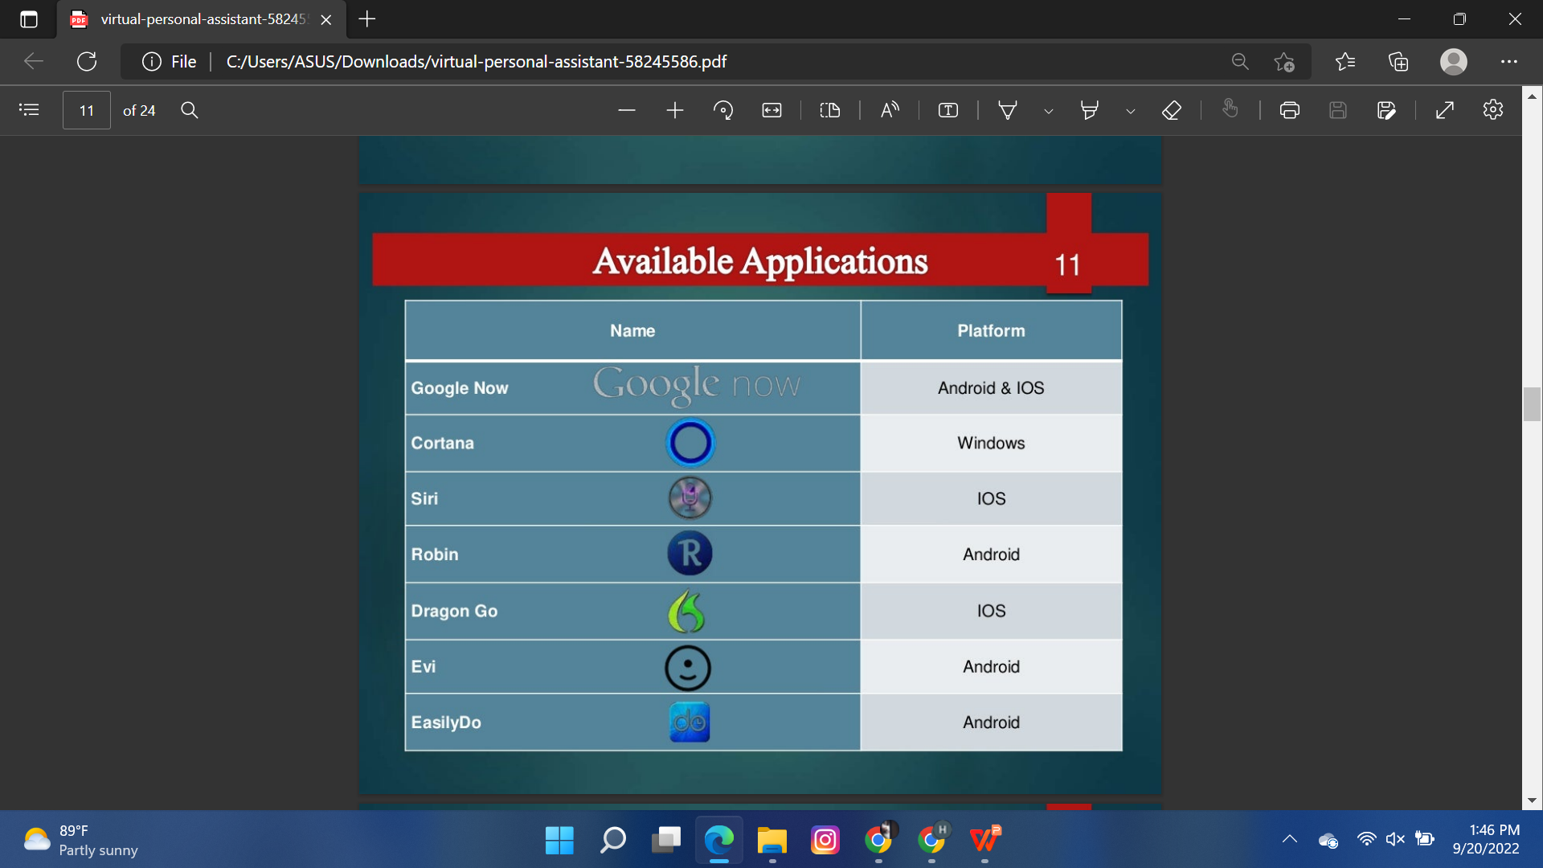
Available Applications and Our Features
Features
Speaks Naturally
Communicate with sorroundings
Geofencing and event based services
Grows with you
Get smarter every day
Will entertain you.

Slide 7
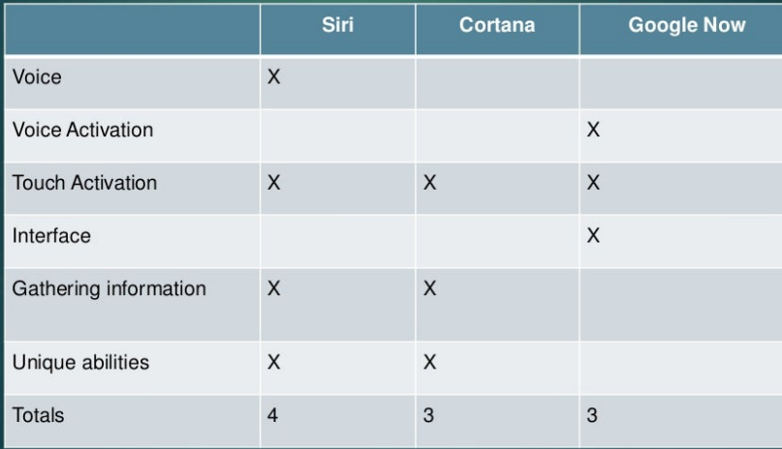
GitHub Repository Link & supporting diagrams, screenshots, if any
https://github.com/Hariharapranav/Virtual-Assisstant

Slide 8
Thank You
Team member names
HARIHARAPRANAV R S
THARUN V
PRAVEENSRI T
KOWSIK J

